Slide 1
Credit Risk & Loan Performance Analysis
Data-Driven Insights for Smarter Lending Decisions
Shubham Kadtan
Tools Used: Excel | SQL (MySQL)

Slide 2
Executive Summary
This project analyzes a financial loan dataset of over 38,000 customer records to uncover patterns of loan delinquency and profitability.
Using SQL and Excel, we examined key factors such as loan term, annual income, and employment length to identify which borrower segments are high-risk or most profitable.
The insights enable financial institutions to:
Reduce non-performing assets (NPAs)
Strengthen lending policies
Improve return on investment through better risk segmentation

Slide 3
Problem Statement
Financial institutions face significant losses due to loan defaults and poor credit risk evaluation.
Understanding which borrower segments are more likely to default and which are profitable is critical for reducing non-performing assets (NPAs) and maximizing return on investment.
This project addresses this challenge by analyzing historical loan data to detect risk patterns and improve lending decisions.

Slide 4
Project Goals
Identify borrower segments with high default rates
Analyze the relationship between loan term, income, and employment with default risk
Calculate interest earned to find profitable segments
Provide data-driven recommendations to reduce risk and increase profitability

Slide 5
Dataset Overview
Feature | Description
loan_amount | Amount disbursed to borrower
loan_status | Loan status (Fully Paid, Charged Off, etc.)
annual_income | Borrower’s annual income
emp_length | Employment length (converted to numeric)
term_months | Loan term (in months)
dti | Debt-to-income ratio
int_rate | Interest rate applied
Total Rows: | 38,576

Slide 6
Methodology
Step 1: Data Exploration Reviewed 38,573 records and 26 columns to understand schema and missing values.
Step 2: Data Cleaning
Removed/replaced nulls (e.g., emp_title, emp_length)
Standardized fields like term, int_rate, and emp_length
Cleaned columns for SQL compatibility (renamed, formatted)
Step 3: Data Import Loaded cleaned dataset into MySQL for structured querying.
Step 4: Data Analysis Wrote SQL queries to analyze default rates by multiple borrower attributes.
Step 5: Visualization Created charts in Excel based on SQL outputs to highlight insights.

Slide 7
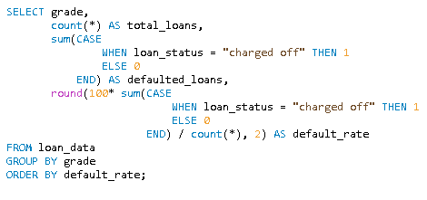
Which credit grades have the highest loan default rates?
Default risk increases significantly as credit grade drops. Borrowers in grades E, F, and G show default rates above 24%, with Grade G peaking at 31.31%, compared to just 5.7% for Grade A. These low-grade segments should be flagged as high risk and priced accordingly to offset potential losses.

Slide 8
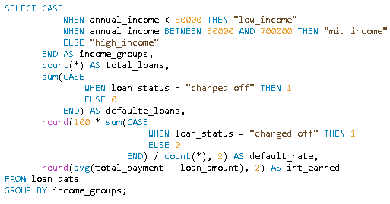
How does income level impact loan default rates?
Borrowers in the low-income group have the highest default rate at 17.44%, compared to 13.47% for mid-income and 10.53% for high-income groups. This suggests that income level is inversely related to default risk — lower-income borrowers are more likely to default. Lenders should apply stricter screening or offer smaller loan amounts for low-income applicants to mitigate risk.

Slide 9
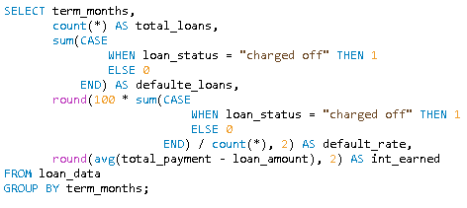
Are longer loan terms riskier in terms of default?
Loans with a 60-month term have a significantly higher default rate compared to 36-month loans. This indicates that longer repayment periods are riskier for lenders, possibly due to increased uncertainty over time. Lenders should apply stricter credit checks or limit high-term loans to low-risk profiles.

Slide 10
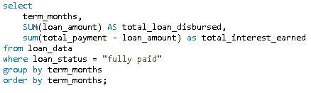
Which loan term generates more interest for the lender?
Although 60-month loans have a higher default risk, they generate significantly more interest than 36-month loans. This makes them more profitable if properly risk-managed, suggesting lenders should balance return with risk using stricter eligibility filters for longer-term loans.

Slide 11
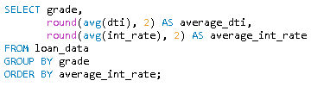
Do interest rates and DTI vary across credit grades?
As credit grade worsens from A to G, the interest rate increases sharply, while DTI (Debt-to-Income ratio) stays relatively stable between 12%–14%. This indicates that interest rates are strongly tied to credit grade risk, not just borrower financial load. Lenders appear to price risk effectively, charging higher rates for lower grades regardless of DTI.

Slide 12
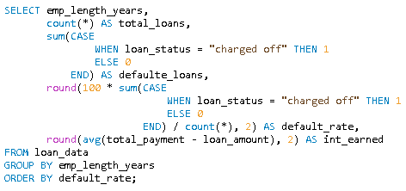
Does employment length affect loan default risk?
The default rate remains fairly consistent across all employment lengths, ranging between 12.8% and 13.8%, with no strong trend. This suggests that employment length alone is not a significant predictor of loan default, and should be considered alongside other factors like income or credit grade.

Slide 13
Insights Summary
Default risk increases significantly from Grade A (5.7%) to Grade G (31.3%) — lower-grade loans carry the highest risk.
Low-income borrowers have a 17.4% default rate, much higher than high-income borrowers (10.5%).
60-month loans have nearly 3× higher default rates than 36-month loans, showing longer terms carry more risk.
Despite the risk, 60-month loans generate more total interest, making them more profitable if filtered properly.
Interest rates rise with lower grades, but DTI remains stable, showing lenders already apply risk-based pricing.
Employment length has minimal effect on default rates — not a strong standalone predictor.

Slide 14
Recommendations
Avoid or adjust pricing for low-grade loans (E, F, G) due to high default rates above 24%. These should be offered only to well-screened applicants or at higher interest rates.
Apply stricter screening to low-income borrowers, as they show a default rate of 17.4% — higher than mid- and high-income groups.
Limit or risk-adjust 60-month loan offerings, since they carry nearly 3× higher default risk compared to 36-month terms.
Offer long-term loans only to low-risk borrowers, as they generate more interest and can be highly profitable when defaults are low.

Slide 15
Thank You

